Slide 1
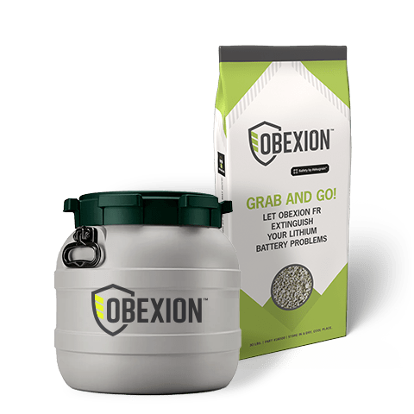

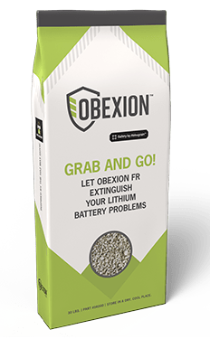
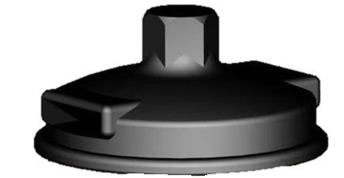
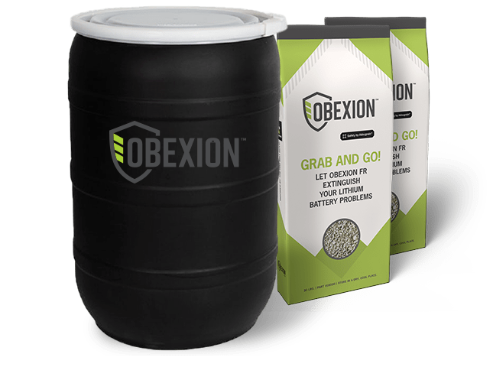
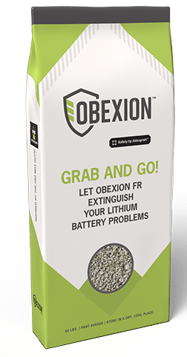
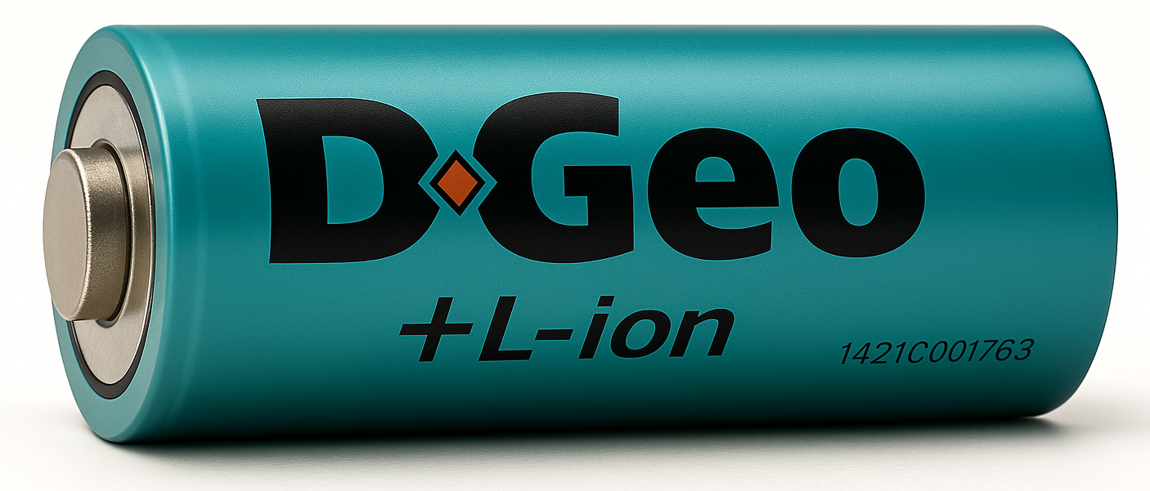
OBEXION FR – FIRST RESPONDERS
“Let it Burn”
42 Liter
UN Certified Kit
Certified at 100% SOC
Filters out many of the toxic gases
Exterior temp remains ambient
Certified solution
Easy to use
Regulatory compliant
15 LB Bag
Loose Obexion FR
P/N: 15001
P/N: 16001
30 LB Bag
Loose Obexion FR
30 Gallon
UN Certified Kit
P/N: 16000
P/N: 15000

